Slide 1
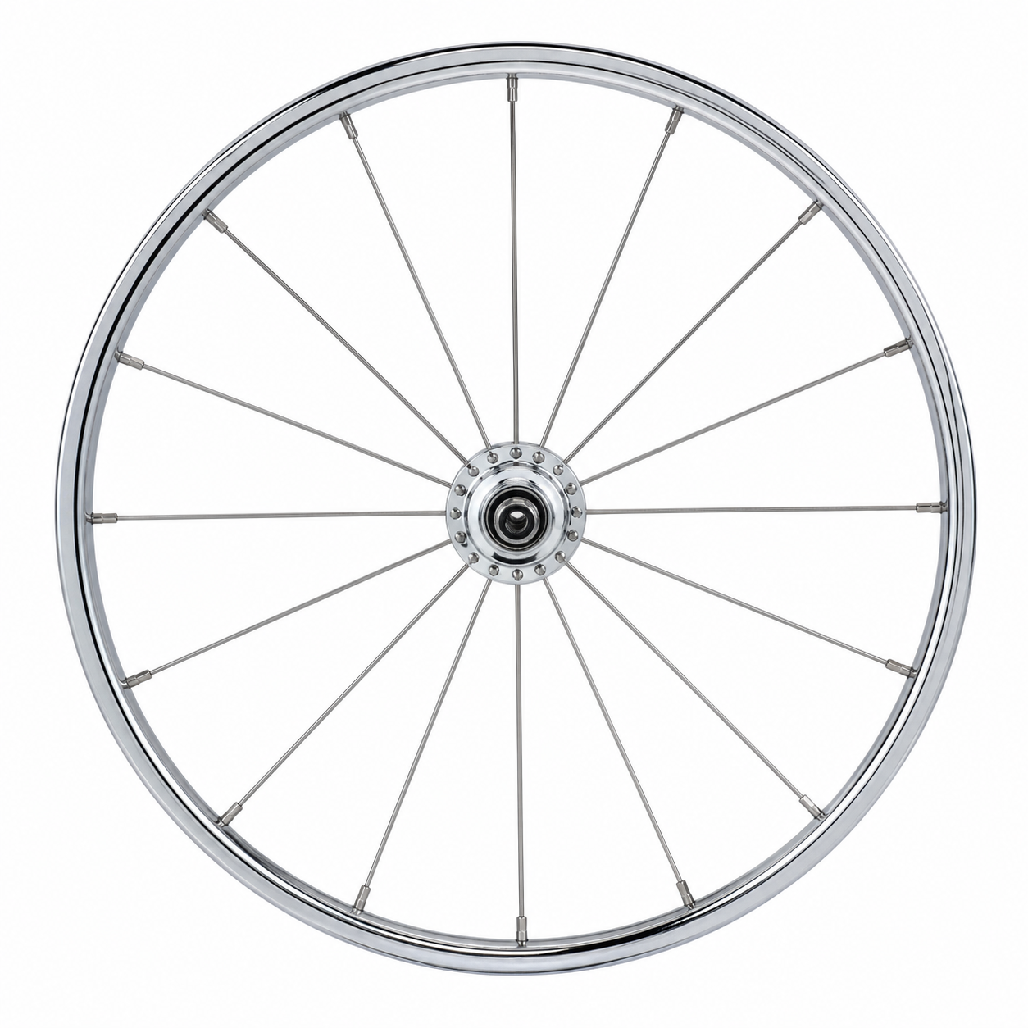
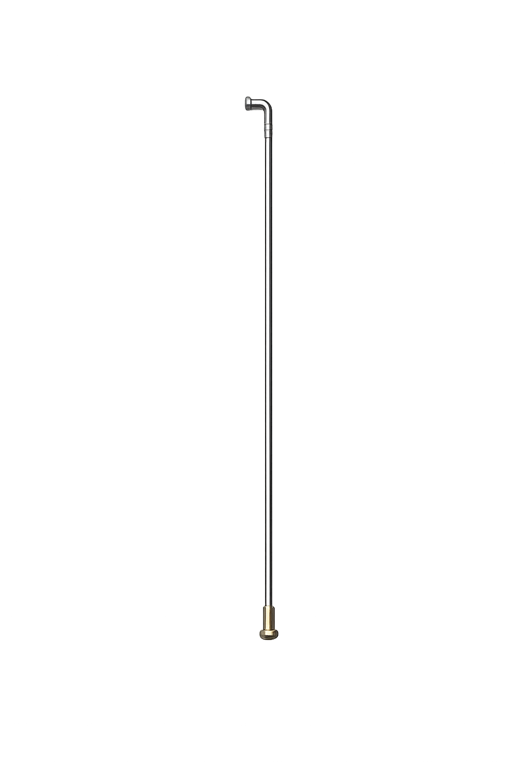
Joel
Isaiah
Nahum
Malachi
Micah
Psalms
Ezekiel
Hosea
Moses
Deut 30:1-9
Daniel
Amos
Zechariah
Obadiah
Jeremiah
Jonah
Habbakuk
Haggai
Zephaniah

